Slide 1
Architecture of Custom Microsoft 365 Solutions
Paolo Pialorsi
Senior Consultant, PiaSys.com
@PaoloPia

Slide 2
Abstract
Microsoft 365 is not just one of the best set of collaboration tools to realize the modern digital workplace. Microsoft 365 is a great platform for building business-level solutions, too. In this session, you will understand how to define the architecture of a Microsoft 365 custom developed solution, how to leverage the infrastructural services that are at the basis of Microsoft 365, and how to leverage the full ecosystem of services provided in the Microsoft 365 offering. You will understand what is the right location in a business-level architecture for services like Azure AD, Microsoft Graph, Azure App Services, Azure Functions, etc.

Slide 3

About me
Paolo Pialorsi
I work in a company of my own (PiaSys.com)
Based in Italy and the USA
Support ISVs and Enterprises migrating solutions to Microsoft 365
I love spending time
With my family
Working (because I love my job!)
Driving my car
Subscribe to my YouTube channel: https://piasys.com/TechBites
Follow me on Twitter @PaoloPia

Slide 4
Agenda
Architecting a Microsoft 365 solution
Understanding the out of the box services and tools in Microsoft 365
Understanding the role of Microsoft Azure
Putting it all together, in a real solution: Microsoft Look Book site
Side note: Here I’m going to share my own experience on the fields

Slide 5
Why building a Microsoft 365 “Solution”?
Microsoft 365 offers highly available and well-known services
Azure Active Directory (identity management, authentication, authorization, federation, guests support, etc.)
Exchange Online (mail, calendar, contacts , etc.)
SharePoint Online (documents, pages, content , etc.)
OneDrive for Business (files and sharing)
Microsoft Teams (channels, chats, communication, integration, etc.)
Yammer (outer loop communication)
Power Platform (Power Apps, Power Automate)
Productivity and Time Management (Planner, To Do, Bookings, MyAnalytics, etc.)
Security services (Threat Protection, Information Protection, Compliance, etc.)
Office client and web (Word, Excel, PowerPoint, OneNote, Access, Outlook)
Windows 10
Microsoft Graph (integration and development surface)
Microsoft SharePoint Framework (development and extensibility technology)
Instead of re-inventing the wheel … just build solutions on top of this rich and huge ecosystem

Slide 6
What kind of solutions on Microsoft 365?
Process automation
Document management
Approval flows
HR procedures
HSE procedures
R&D processes
Etc.
Automated provisioning (and update, and decommissioning)
Sites in SharePoint Online
Teams in Microsoft Teams
Sites + Teams in Microsoft 365
Page templates in SharePoint Online
Users at tenant level
Etc.
Line of Business solutions/integrations
Purchase Orders
Customers/Suppliers signup/registration
Quality Assurance
Etc.

Slide 7
Main Technical Challenges
High Availability and Scalability
Security: Authentication and Authorization
UI Elements
Business Logic
Hosting
Multiple environments (DEV, TEST, STAGING, PROD)
Multiple tenants (DEV, TEST, STAGING, PROD)
Content Repository
Monitoring and telemetry
Maintainability

Slide 8
HA and Scalability - Persistence Storage
Where can I store data, if any?
Try to keep all of your data as close as you can
What kind of data do you need to store?
Lists of items, objects, etc.
If data is “truly relational” use Azure SQL Database (+ Entity Framework)
If data is not relational or if you need polyglot persistence use Azure Cosmos DB
Avoid using SharePoint Lists of items as a database surrogate
Slow performances
List view threshold
Complex querying system (CAML or OData)
Eventually, consider Microsoft List …
Documents/Files
Try to use SharePoint Online/OneDrive for Business
Use Microsoft Graph (or SPO REST) to access files
CSOM for SharePoint is not yet available for .NET Standard/.NET Core

Slide 9
HA and Scalability - Custom Code
Avoid code-based solutions as much as you can
I know, I’m a developer … but I’m a “responsible developer” …
Before re-inventing the wheel … try to use what you already have out of the box
Every single module of custom code must be highly available and scalable
Out of the box services are (should be) highly available and scalable by default
You are responsible of making your own code HA and scalable
If you really need custom code
Make it asynchronous (always)
Repeatable
Idempotent
Monitorable
Maintainable “on the go“
Mind the versioning
Carefully plan deployment and release plans

Slide 10
HA and Scalability – Always write Async code
Avoid writing business logic code in the UI (Web Part, UI widget, etc.)
Use the UI to collect and validate information from users
Use an asynchronous back-end of micro-services to execute the real business tasks
Asynchronous communication model between front-end and back-end
Azure Functions (eventually Azure Durable Functions)
Azure Blob Storage Queue
Azure Service Bus
Never live-execute complex tasks, rather enqueue requests to execute them

Slide 11


Some Asynchronous Programming Models
Web-based UI or Native app
Durable Function
Durable Function
Microsoft 365
Front-end
Web-based UI or Native app
Storage Queue
Job/Function
Microsoft 365
Front-end
Web-based UI or Native app
ServiceBus
Job/Function
Microsoft 365
Front-end

Slide 12
HA and Scalability - Caching
The best way to fast execute code is to not execute it!
Use caching!
Use Azure Cache for Redis to store objects, state information, etc.
Use Azure Blob Storage to store blobs/binaries instead of requesting them every single time
SharePoint Online/OneDrive for Business for storing files to share or to convert (to PDF for example)

Slide 13
Security – Authentication and Authorization
Microsoft 365 security relies on Azure Active Directory (AAD)
Always use AAD as your main repository for users, roles, apps, permissions
Register all of your applications in AAD
Front-end apps will authenticate users and leverage delegated access tokens
Back-end apps will provide secure services to the front-end apps
Either on behalf of the user, or with application only tokens
Single-tenant or Multi-tenant?
General rule:
Is your app for your own company (=tenant)? Single-tenant
Are you selling/providing the app to many customers (=tenants)? Multi-tenant

Slide 14
OAuth is your best friend!
Configure authentication for your applications
Application only?
Prefer X.509 Certificate authentication, rather than Shared Secrets
Configure permissions that you need
Delegated: if you need to execute tasks for the currently connected user only
Web front-end
Native application
Application: if you need to execute tasks with a “service principal” account
Azure Function
PowerShell script
Web Job
Etc.
Request access tokens
On-behalf: if you need a back-end multi-layered architecture to behave as the currently connected user

Slide 15
Safely Storing Security Information
Use Azure Key Vault to safely store security information
Tokens
Passwords
Certificates Private Keys
Sensitive Application Settings
Other “sensitive” information
Avoid high-volume traffic on Azure Kay Vault
Or you will get throttled
The service is not intended for high-volume writes
It is ok to have high-volume reads
Delegate access to Azure Key Vault to Azure Managed Identities
Or to AAD apps only, with X.509 certificate app-only authentication
Rather than allowing access to specific users

Slide 16
UI Elements
Try to use Microsoft Teams as the host for your UI elements
If you need more complex scenarios, consider SharePoint Framework Web Parts
Do you need to collect information from users?
Microsoft PowerApps + Microsoft Teams
Adaptive Cards + Microsoft Teams
Logic Apps/Power Automate + Adaptive Cards + Microsoft Teams
Do you need to provide feedback to the users?
You can write on a Channel/Chat via BOTs, Graph API, etc.

Slide 17
Business Logic
There are at least three options
Power Automate
Azure Logic Apps
Custom Code
Power Automate
Great for “personal” processes and flows
User centric SaaS
Mainly focused on approval processes, synchronization, notifications, etc.
Integrated with main out of the box workloads of Microsoft 365 and external well-known apps
Azure Logic Apps
Ideal solution for enterprise-level processes/solutions
Process centric PaaS
Deeper integration with external systems (EDI, B2B systems, etc.)
At the basis of Power Automate (same engine, same web-based designer, same connectors)
Designer for Visual Studio
Custom Code
Whenever you need to do something “uncommon”
Mind the “hidden” cost of management and maintenance

Slide 18
Microsoft Graph is your master key!
Use Microsoft Graph to read and manage Microsoft 365 resources
Users and Groups via Azure Active Directory
Teams (Channels, Tabs, Messages, etc.)
Planner
Mail
Sites
Files
Etc.
Try to use v1.0 of Graph, and fall back to beta if it is really needed
For example to leverage new features not yet released in v1.0
Microsoft Graph is the main reason why you should always register you apps in AAD

Slide 19
Hosting
Consider using Azure App Services and Azure Web Apps
Or eventually Azure Static Web for static content without server-side code (like JS/CSS/etc.)
You can easily enable CDN, too
Leverage the deployment slots on Azure App Services
Leverage the AAD integration for Authentication on Azure App Services
Leverage Azure Web Jobs sharing the same hosting (Azure App Service)
Leverage Azure Functions sharing the same architectural model and a better execution and pricing model
Try to use .NET Standard/.NET Core to have lightweight solutions
Eventually containerized

Slide 20
Multiple Environments
What if you need to support DEV, TEST, STAGING, PROD?
You can leverage deployment slots on Azure App Services
Multiple environments
Shared settings and/or slot dedicated settings
Independent lifecycle for every slot
Quick swap across environments (from TEST to PROD)
Progressive testing (split users: 30% STAGING – 70% PROD)
Unique budget across the whole Azure App Service

Slide 21
Multiple Tenants
I usually have a dedicate DEV tenant
It’s free (https://developer.microsoft.com/en-us/microsoft-365/dev-program)
As long as you use it, it will keep on working
If you don’t use it … it will expire
I try to use a unique tenant for TEST, STAGING, PROD
You can share the same users (in AAD + AD Sync/ADFS) and permissions
You can share the same taxonomy for read
You can share the same app registrations in AAD
You can use local Site Collection app catalogs for local testing or version upgrade test
It is not always possible to share the same tenant for TEST, STAGING, PROD
What if the app is reading and writing taxonomy?
What if the app provisions users, resources, and allocated licenses?
What if the app “touches” or requires specific tenant-level settings?

Slide 22
Content Repository
Do you need to store documents only?
Consider using OneDrive for Business for files
You can even think about using OD4B to store personal user’s settings (as JSON files)
To have the same settings automatically shared across all the user’s environments
Do you need to store documents and metadata?
Consider using SharePoint Online
With custom Fields, Content Types, and Libraries
Avoid using the Content Type Hub
Prefer to use a remote provisioning technique (PnP Provisioning Engine)
To keep Content Types in sync with a custom job/function hosted on Azure
For supporting long-term documents
Always prefer a structured Information Architecture in SharePoint Online
Do you need external contributors for content?
Think about using GitHub repositories
Issue, Commit, Pull Request, Merge, History, etc.
Read content from GitHub via REST API

Slide 23
Monitoring and Telemetry
Azure Application Insights for monitoring and storing telemetry of your code
Performance
Issues
Requests flow
Custom events and tags
Etc.
And what about users’ behavioral analysis?
Azure SQL Database for symmetric relational data logging
Use back-end asynchronous logging events through Azure Functions
Azure Cosmos DB for asymmetric no-SQL data logging
Either way, build powerful dashboards with Microsoft Power BI

Slide 24
Maintainability
Always define maintenance plans while defining the solution architecture
Think the architecture as a maintainable architecture
Don’t think about maintenance as a “side effect” of the architecture
Use technologies that allow you to make “warm” updates
Azure App Services (with deployment slots)
Azure Service Bus (not Blob Storage Queue)
Azure SQL Database + Entity Framework (with data migrations)
Keep into account versioning
Avoid using technologies that cannot guarantee versioning
You need to be able to “rollback” a failing change
You need to be able to “track” history and versions

Slide 25
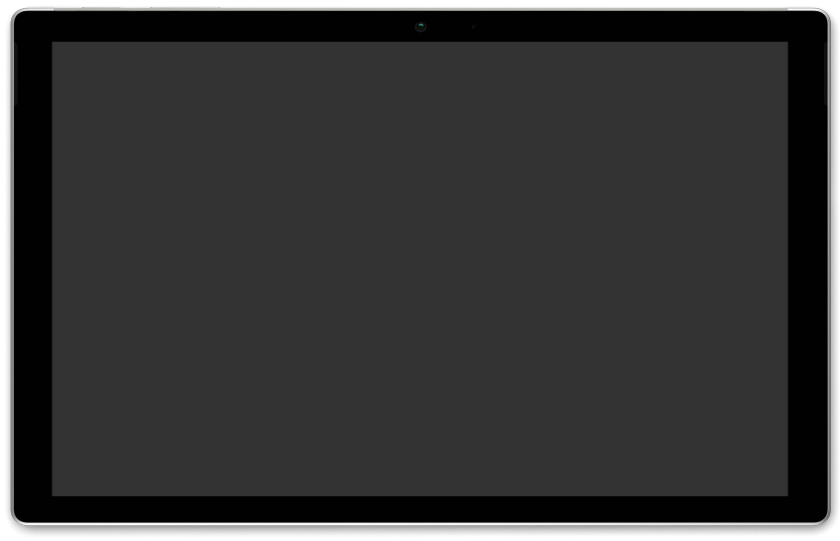
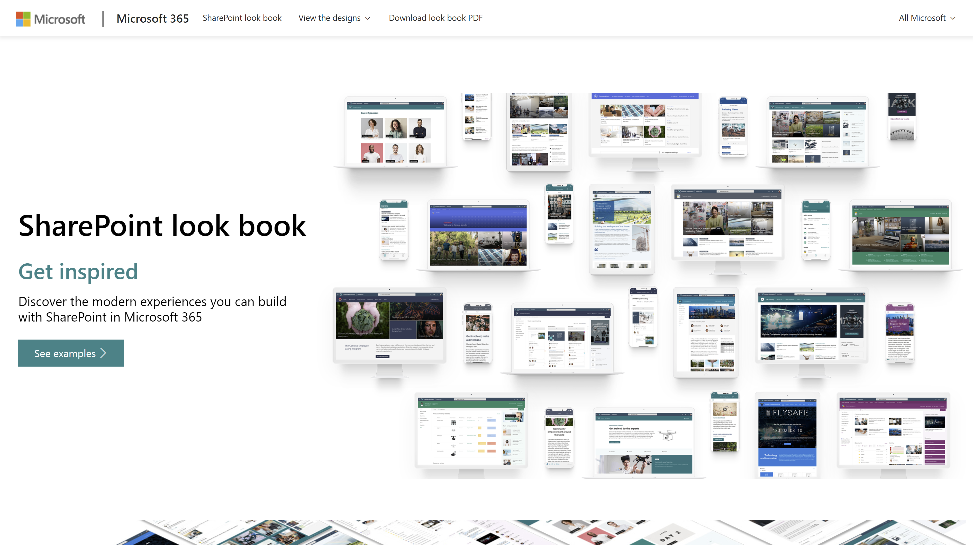
Microsoft SharePoint Look Book
As a wrap up, let’s have a look at a real enterprise-level solution architecture on Microsoft 365, designed for scale and highly available

Slide 26

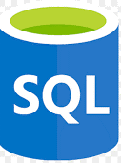
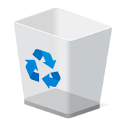

Architectural Schema
Application Insights
Telemetry
Telemetry
https://lookbook.microsoft.com
ServiceBus
WebJob
Create/Update Main Site Collections with PnP Templates
Tenant Admin
Store Refresh Token (encrypted and with expire policy)
Access Token + Refresh Token
OAuth 2.0 Flow
Read Refresh Token
Content
Azure Active Directory
SQL Azure Database
Recycle the Refresh Token (with expire policy)
Get new AccessToken through RefreshToken
Main Site Collections (Modern Sites)
Content Repository
Provisioning Templates

Slide 27
We do care about your feedback!

